Slide 1
Project Report
Somil Taneja

Slide 2
Introduction
Our "Domain Sale" process is structured to help potential buyers purchase the domain they want immediately without the hassle of contacting the seller directly. A seller lists a domain for sale at a specific price in our Marketplace. An interested buyer sees this domain for sale and decides to buy it.

Slide 3
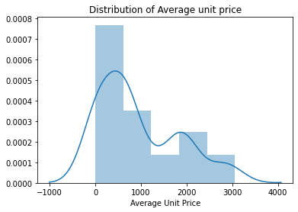
Insights
According to the above distribution plot we can conclude that maximum of the product unit price is below $1000

Slide 4
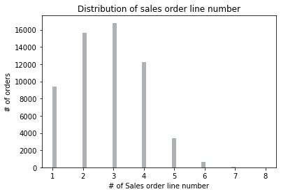
Most of the time three to two products are ordered in a single order.

Slide 5
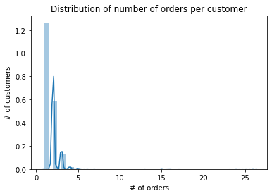
Maximum quantity ordered for a product is below 5.

Slide 6
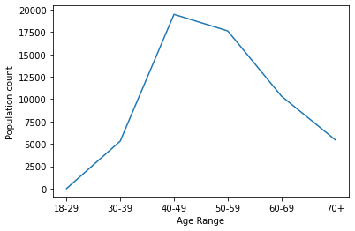
A sizable portion of the clientele is made up of people between the ages of 40 and 59 .

Slide 7
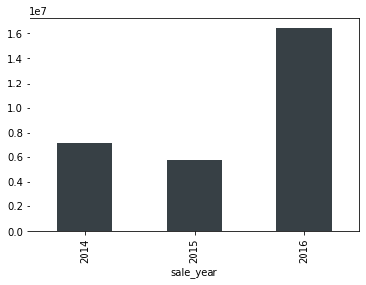
The year 2016 saw an exponential surge in sales.

Slide 8
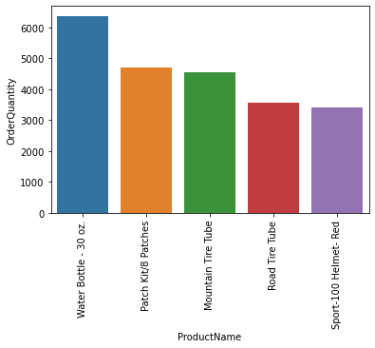
Top 5 selling products

Slide 9
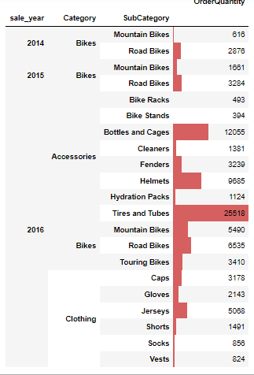
Quantity ordered based on category and subcategory from
2014 to 2016

Slide 10
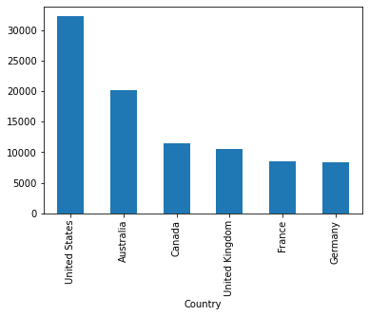
▪ High quantity of products is ordered from Australia and United States

Slide 11
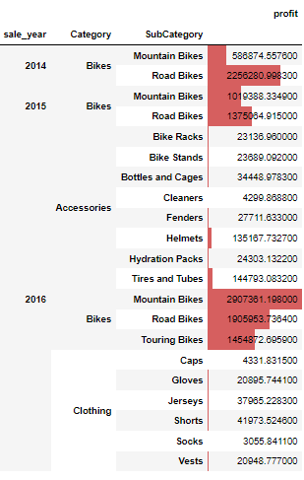
Overall profit based on order year, category and subcategory.
Major Profit is contributed by the Bike Category.

Slide 12
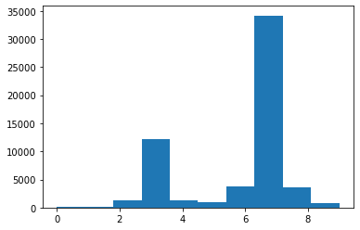
The average order has a gap of 7 days between the day the order is ready for export from the factory and the date it was shipped ▪ Management must work to reduce this gap toward 3 days

Slide 13
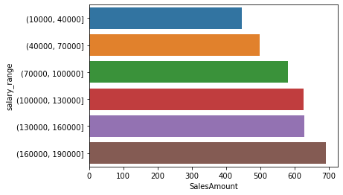
▪ High salary range leads to increase in revenue

Slide 14
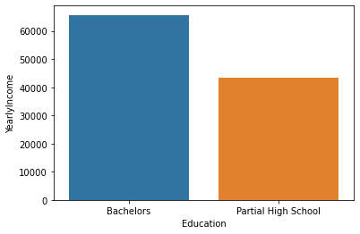
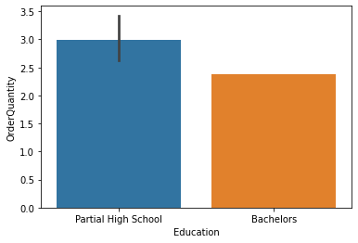
Customers with a high school diploma and modest annual income buy more products than people with bachelor's degrees .

Slide 15
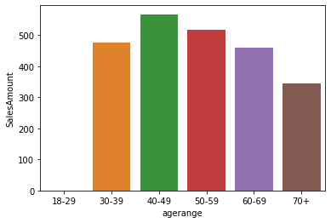
40-49 age group has produced most revenue.

